Slide 1

Sentiment Analysis
Using Natural Language Processing and Neural Networks to determine the sentiment of IMDb review

Slide 2

Theory of the Project
Looking at a dataset of 50,000 movie reviews on IMDb, I use sentiment analysis to predict whether the review was positive of negative based on the text portion of the review

Slide 3
Sample Review
I gave this film my rare 10 stars. When I first began watching it and realized it would not be a film with a strong plot line I almost turned it off. I am very glad I didn’t. … In addition to excellent performances by all members of the cast, there is some fine singing and dancing from that era.
Possible signal words???

Slide 4
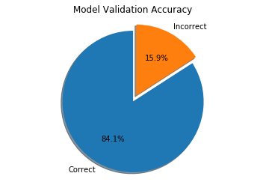
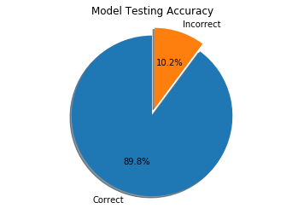
Performance of the model

Slide 5
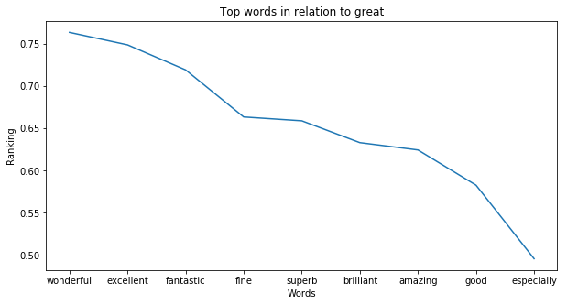
Most Indicative Words

Slide 6
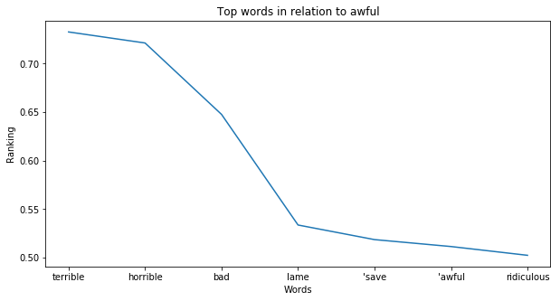
Most Indicative Words

Slide 7
Conclusions
Model Performs with around 88% Accuracy
Sentiment classification is possible with high confidence after data manipulation
Certain words have high impacts on the probability of sentiment prediction

